Slide 1
Computer Vision using Python Pest & Disease Detection in Field Crops (Precision Agriculture)
Group No. 10
Team Member 1 : Nakul Jadhav ( AI & DS 20252029 )
Team Member 2 : Neel Javiya ( AI & DS 20252030 )

Slide 2
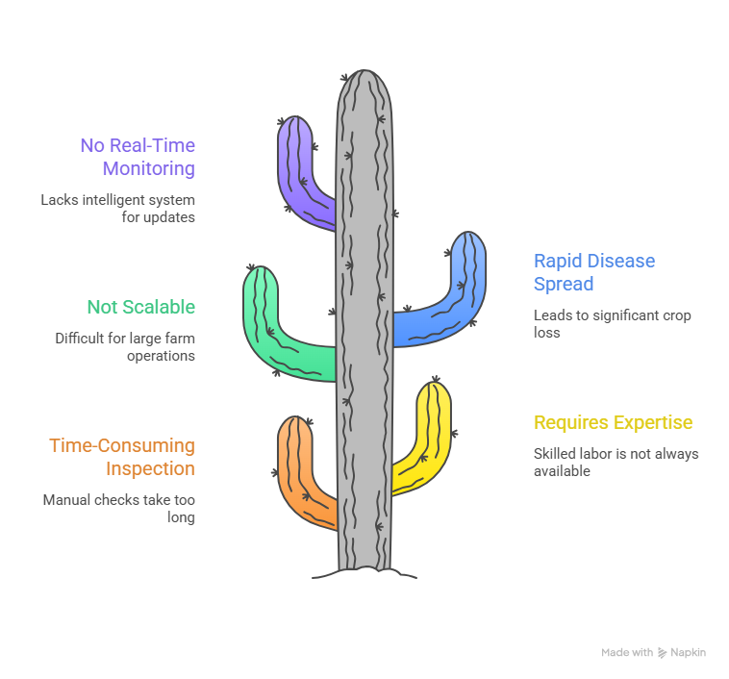
Problem Understanding
“So our goal is to automate this process using AI for faster and more accurate detection.”

Slide 3
Why ?

Slide 4
Motivation
Agriculture is a critical sector for economy & food security
Crop diseases & pests cause major yield loss (20–40%)
Farmers lack access to advanced diagnostic tools
Need for:
✔ Fast detection
✔ Accurate diagnosis
✔ Scalable solution

Slide 5
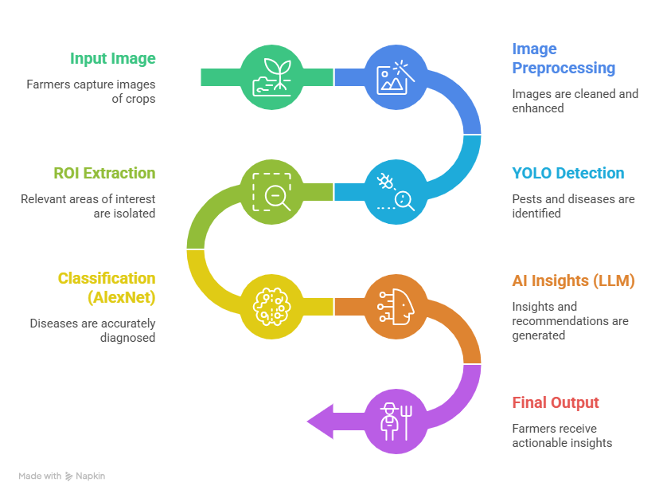
System Architecture / Pipeline

Slide 6
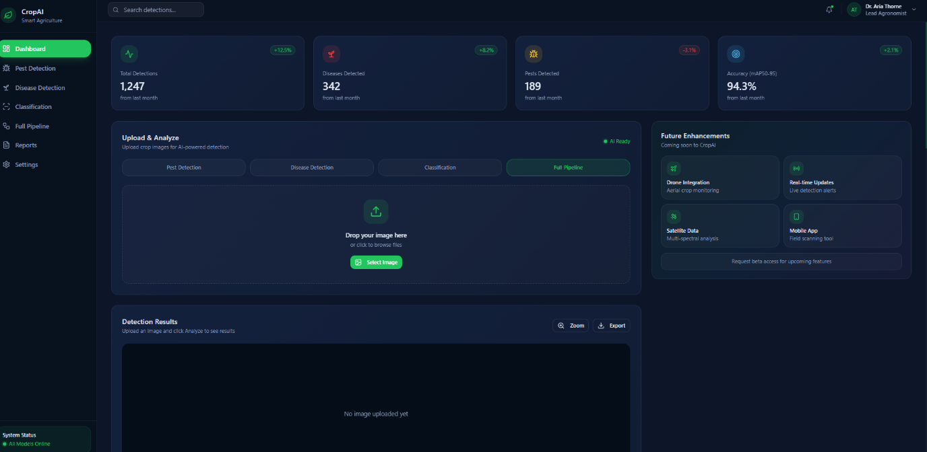
Dashboard

Slide 7
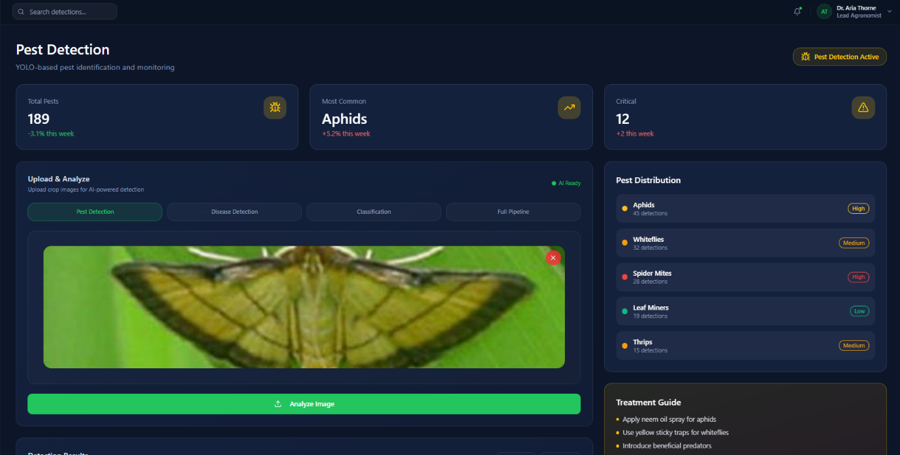
Pest Detection ( YOLO )

Slide 8
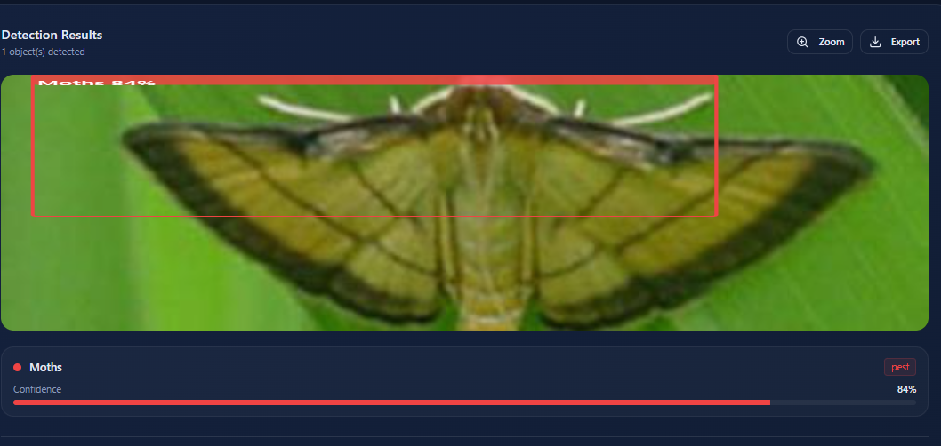
Pest Detection ( YOLO )

Slide 9
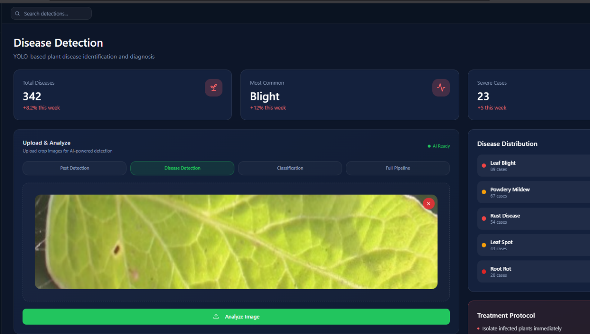
Disease Detection ( YOLO )

Slide 10
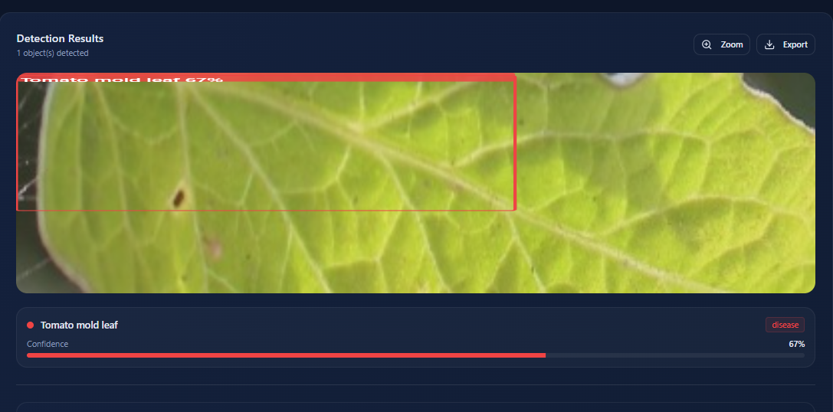
Disease Detection ( YOLO )

Slide 11
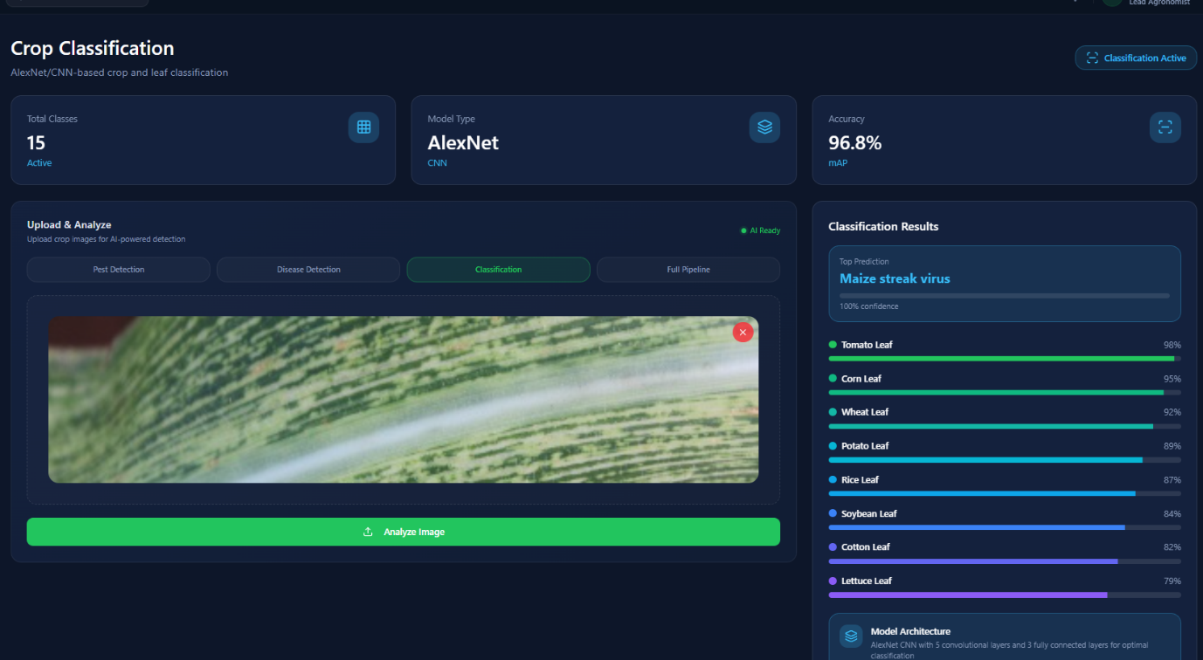
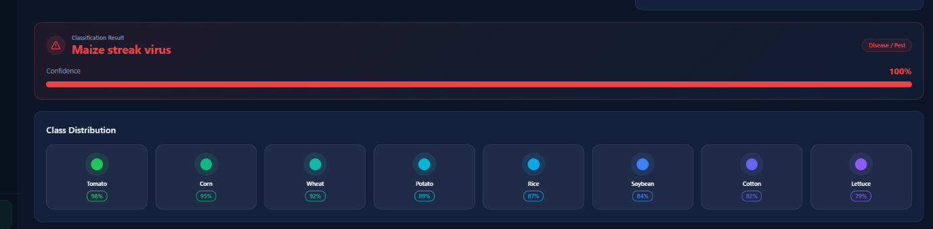
ABLATION STUDY ( Classification Focus )

Slide 12
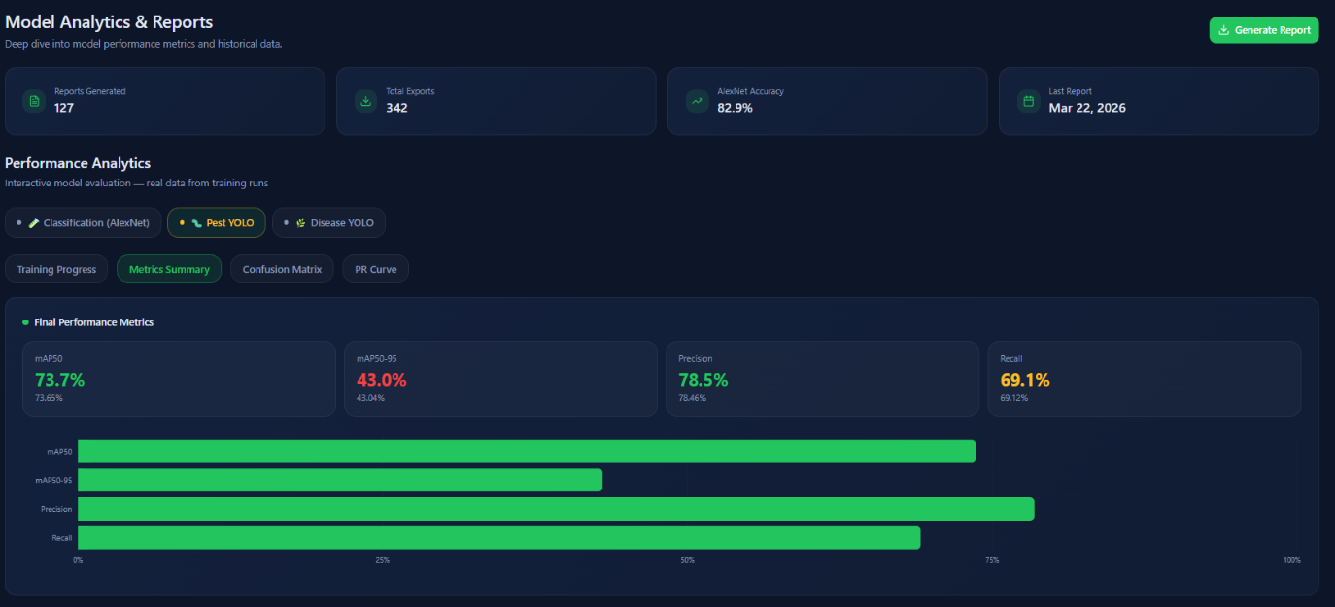
Model Evaluation & Results

Slide 13
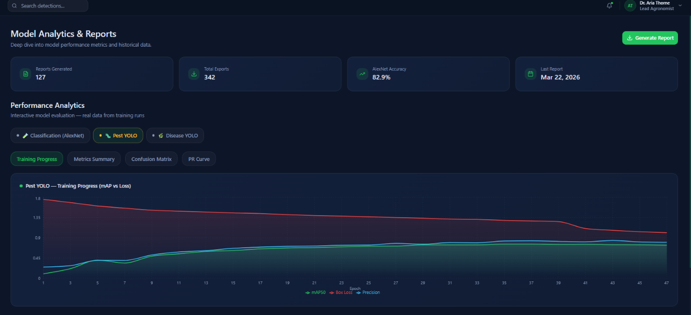
Model Evaluation & Results

Slide 14
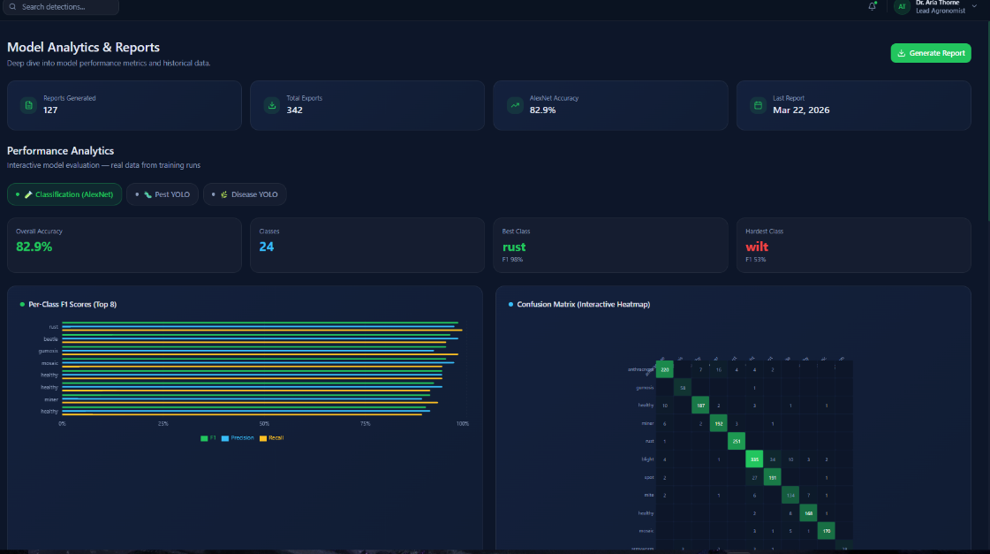
Model Analytics

Slide 15
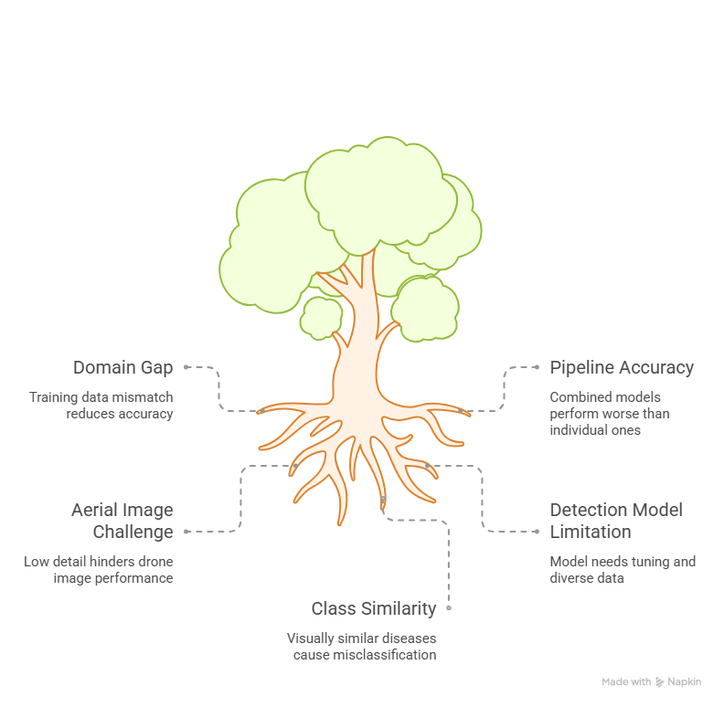
Limitations

Slide 16
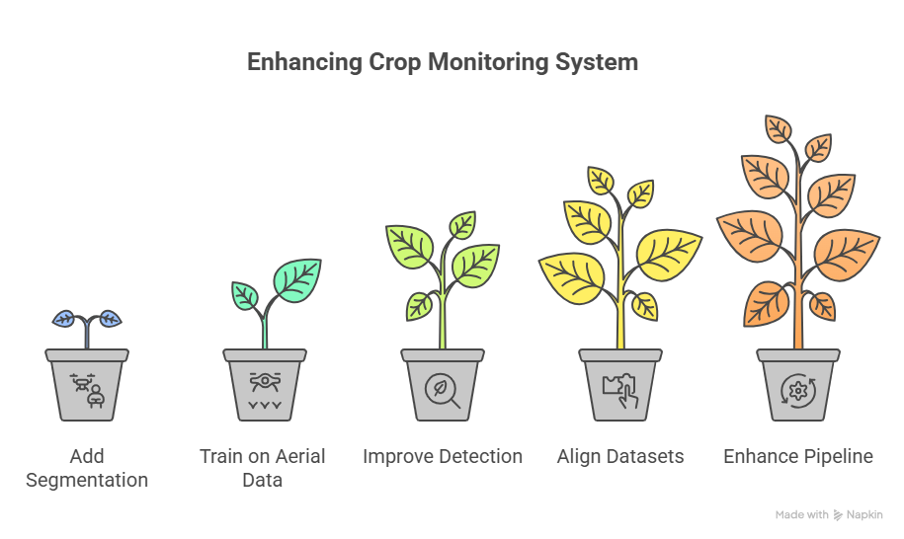
Future Scope / Improvements

Slide 17
Money…

Slide 18
Industry Relevance
Industry Pain Points | CV Solution Mapping
Late Disease Detection | CV enables early, real-time identification from images
Excess Pesticide Usage | Targeted spraying using precise infection detection
Manual Field Inspection | Automated monitoring via mobile apps/drones
Lack of Expert Access | AI-based diagnosis provides expert-level insights

Slide 19
PrecisionHawk ( Case Study )
PrecisionHawk (One of the earliest pioneers)
US-based drone and geospatial analytics company
-- Among the first major companies (early 2010s) to combine:
Drone imagery
Machine learning + computer vision
-- Their platform (PrecisionAnalytics) analyzes aerial images to:
Detect crop stress
Monitor plant health
Identify anomalies (disease/pest patterns)
-- Generated millions in service + software revenue annually

Slide 20
Government Interest
Under the Kisan Drone Promotion Scheme, Central Government has released about 129.19 crore.
For 300 drones apx.
Year | Funding Type | Amount
2022 | Policy + budget support | (Indirect, no fixed number)
2023 | Direct funding released | ₹129.19 crore
2024 | Increased funding | ₹141.39 crore
2025 | Subsidy-based expansion | ₹50–100+ crore (estimated range)

Slide 21
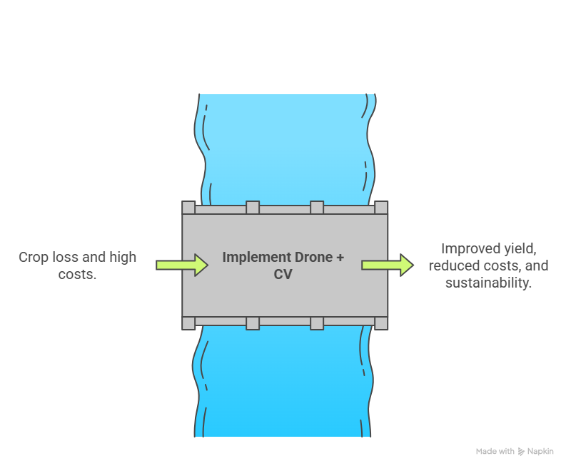
Conclusion

Slide 22

Thank You
Thank You

